Slide 1




Ming Wu (Andrew) 2133861w
Laser Mate!
Project Supervisor Meeting 13
12 February 2021

Slide 2
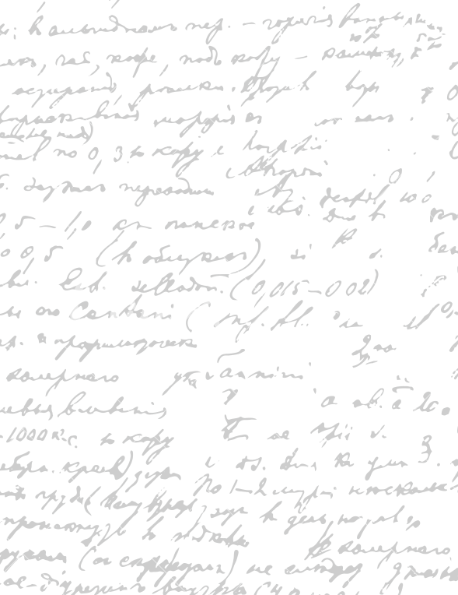



Start Recording

Slide 3
Main Topics
1. Evaluate dissertation

Slide 4



Q1. What is an acceptable number of participants for digital prototype evaluation? 5 per user group
Could you have a look at my evaluation section (paper prototype + digital prototype)? Describe how you will quantitatively conduct the digital prototype.
Q2. What is your comment in the final software product section? (check first two paragraphs)
Q3. What is your thought on the software design section?
Don’t need to educate the reader how you do the experiment, but cnvice the lectuer it is a good design and what you have done don’t have a usability guide
Talk about Limitated participant diue to covid
Paper prototype – what you take in and out, study design and result
1. Evaluate Dissertation
Parts
At least 5 per user groups – limitation
HCI student they are expert
Walkthoguh – ask particular problems in the sheet – online standard
Think aloud- talk as they look at the app - change
Jakob – with other HCI friends

Slide 5
End

